Slide 1


Jason P. Kirst
07/012022

Slide 2

Outline
Executive Summary
Introduction
Methodology
Results
Conclusion
Appendix

Slide 3
Executive Summary
For this project, I performed EDA with SQL, Machine Learning Prediction, Data Collection via API, EDA with Visualization, Interactive Visual Analytics with Folium, Data Collection with Web Scraping, Data Wrangling, and created an Interactive Dash with Plotly.
After performing this EDA and experimenting with four different machine learning algorithms, I was able to produce a model using Decision Tree Classification which predicts successful and unsuccessful landings with approximately 90% accuracy.
Notes:
Summary of methodologies
Summary of all results

Slide 4
Introduction
Space X advertises Falcon 9 rocket launches on its website with a cost of 62 million dollars; other providers cost upward of 165 million dollars each, much of the savings is because Space X can reuse the first stage.
Therefore if we can determine if the first stage will land, we can determine the cost of a launch. This information can be used if an alternate company wants to bid against space X for a rocket launch.

Slide 5
Section 1
Methodology

Slide 6
Methodology
Executive Summary
Data collection methodology:
Via the SpaceX Data API and Web Scraping wikipedia.com
Perform data wrangling
Data was processed by converting all relevant facts into numeric values
Perform exploratory data analysis (EDA) using visualization and SQL
Perform interactive visual analytics using Folium and Plotly Dash
Perform predictive analysis using classification models
Once I had wrangled the data and performed EDA, I experimented with 4 different types of common machines learning models and compared their accuracy. The winning model was the descision tree classifier with an accuracy of nearly 90%.

Slide 7
Data Collection
Describe how data sets were collected.
You need to present your data collection process use key phrases and flowcharts
SpaceX API
Web Scraping
Notes:
Describe how data sets were collected.
You need to present your data collection process use key phrases and flowcharts

Slide 8
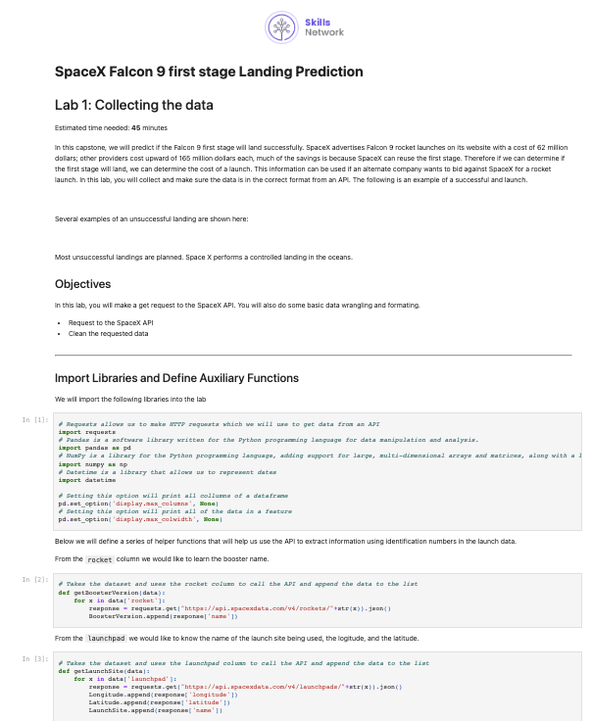
Data Collection – SpaceX API
Notebook
Server
/ launches / past
I collected data using the SpaceX Data API.
First, I called the /launches/past endpoint to collect info on past launches, then I used this data to iteratively pull additional data from the /rockets, /launchpads, /payloads, and /cores endpoints.
json response
/ rockets / [rocket]
json response
/ launchpads / [launchpad]
pandas dataframe
json response
/ payloads / [load]
json response
View Jupyter notebook
/ cores / [core]
json response
Notes:
Place your flowchart of SpaceX API calls here
Present your data collection with SpaceX REST calls using key phrases and flowcharts
Add the GitHub URL of the completed SpaceX API calls notebook (must include completed code cell and outcome cell), as an external reference and peer-review purpose
https://github.com/jasonn1234/Applied-Data-Science-Capstone/blob/master/SpaceX%20Data%20Collection%20API.ipynb

Slide 9
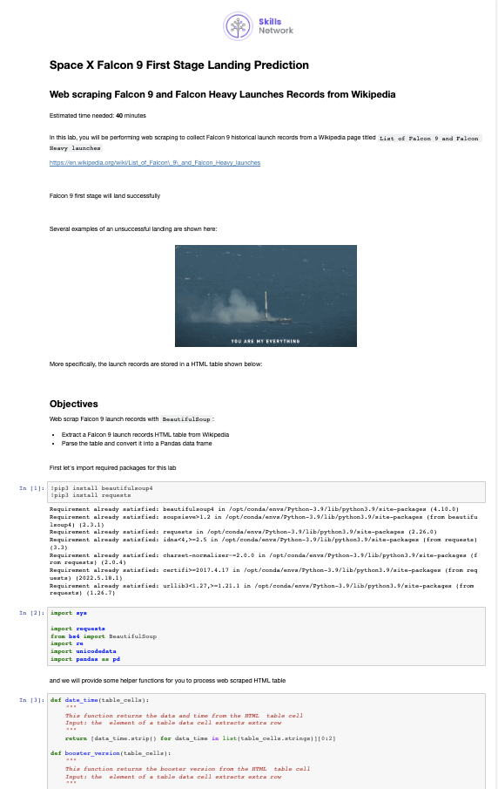
Data Collection - Scraping
Load
Parse
Store
Download HTML using Requests.get() method
Parse HTML into a BeautifulSoup object
Store table as a pandas data frame and then export and CSV
View Jupyter notebook
Notes:
Present your web scraping process using key phrases and flowcharts
Add the GitHub URL of the completed web scraping notebook, as an external reference and peer-review purpose

Slide 10
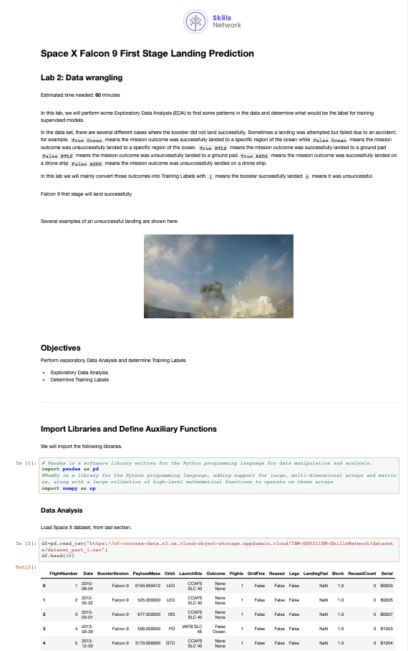
Data Wrangling
Explore
Label
Create a training label "class" which holds numeric representation for landing success
Store
Store the training label values into a new column in the dataframe and export as CSV
Determine which columns and row values equate to a successful landing
View Jupyter notebook
Notes:
Describe how data were processed
You need to present your data wrangling process using key phrases and flowcharts
Add the GitHub URL of your completed data wrangling related notebooks, as an external reference and peer-review purpose

Slide 11
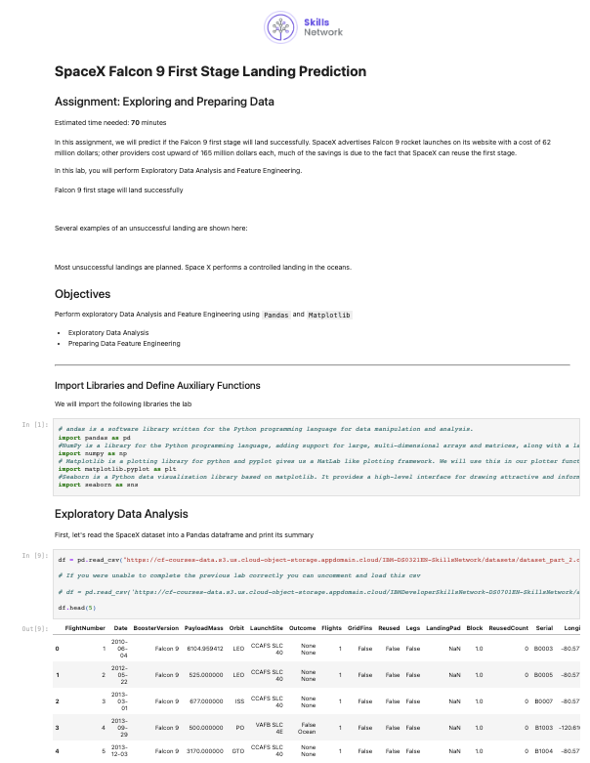
EDA with Data Visualization
Using scatter plots and bar charts, I explored the relationship between class and payload mass, orbit type, flight number, landing pad, launch site, and booster version.
The strongest correlations appeared to be with Flight Number and Payload Mass.
It appeared that flight success improved over time, and with heavier payloads.
Payload Mass
Orbit Type
Landing Pad
Class
Flight Number
Launch Site
Booster Version
View Jupyter notebook
Notes:
Summarize what charts were plotted and why you used those charts
Add the GitHub URL of your completed EDA with data visualization notebook, as an external reference and peer-review purpose

Slide 12
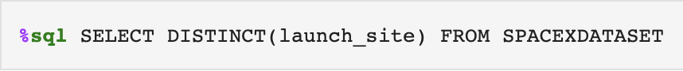
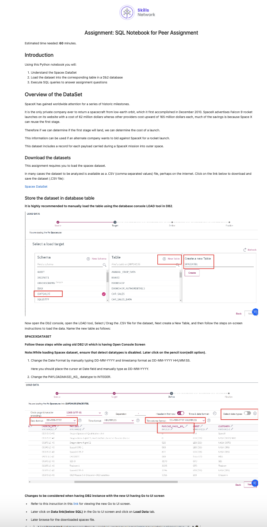
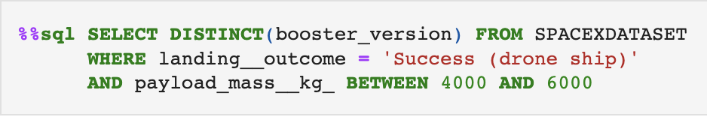
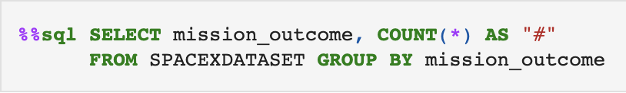
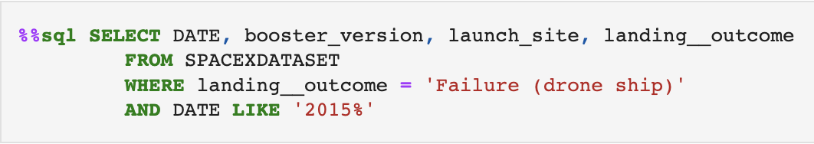
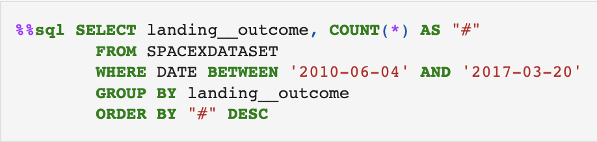
EDA with SQL
View Jupyter notebook
Notes:
Using bullet point format, summarize the SQL queries you performed
Add the GitHub URL of your completed EDA with SQL notebook, as an external reference and peer-review purpose

Slide 13
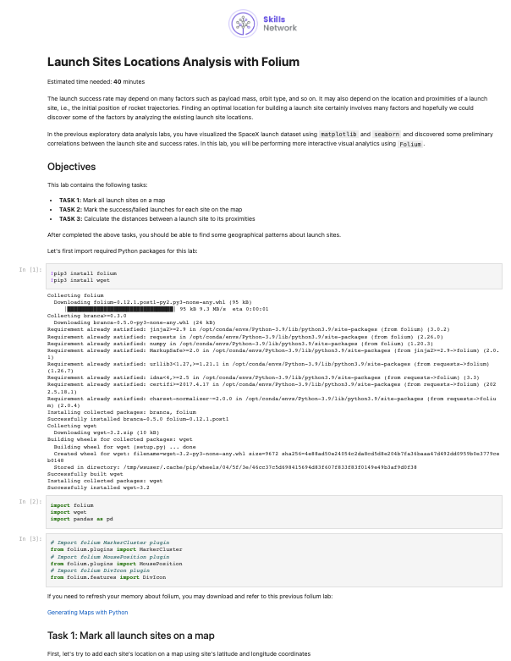
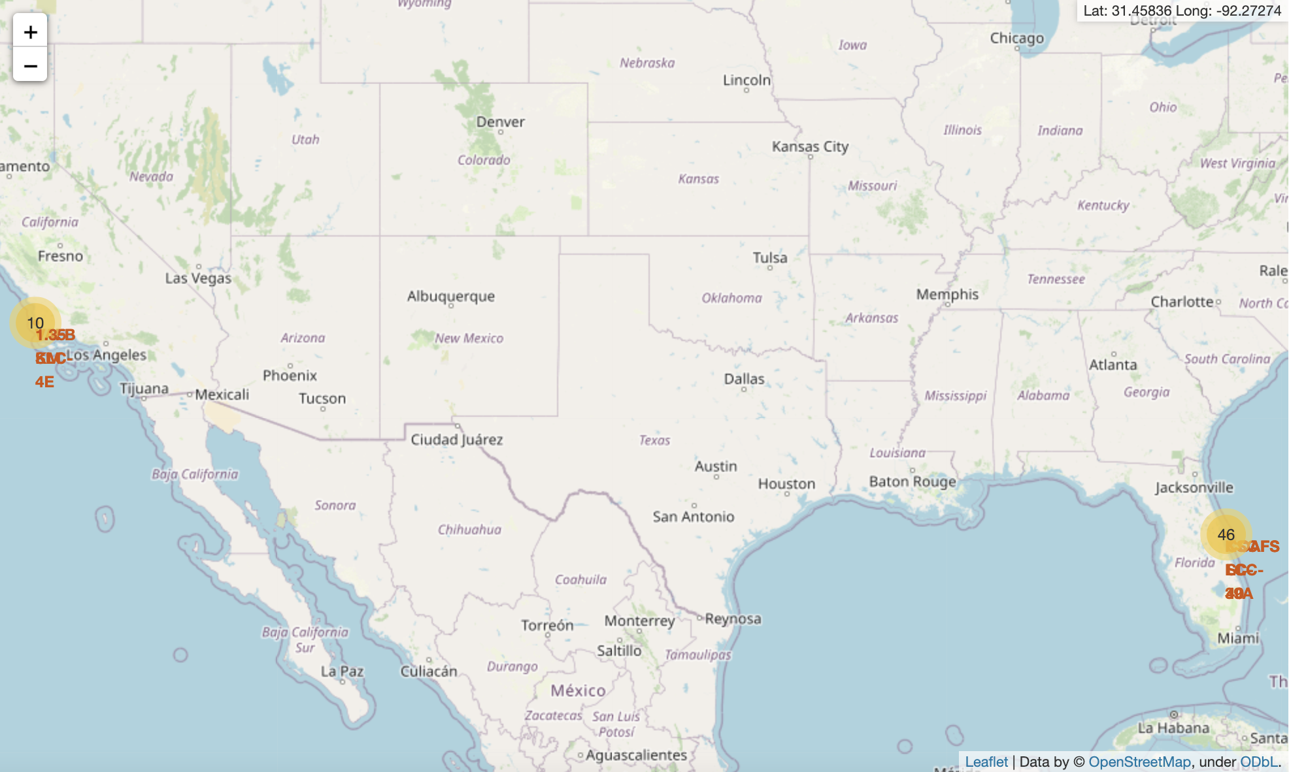
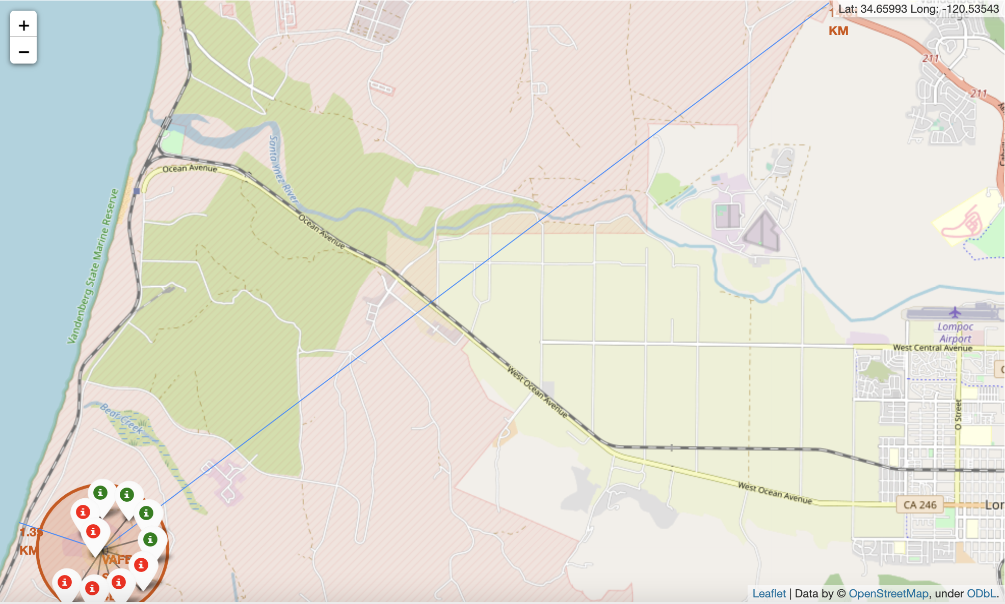
Build an Interactive Map with Folium
I added markers for each launch site onto the map. Since many launch sites were relatively close together, I used Marker Clusters.
For one site, I also drew lines to the nearest coastline and to the nearest highway.
For this EDA, I was able to infer that the launch sites were (a) in the south, close to the equator, (b) close to the coast, and (c) relatively far away from any major city, highway, or railway.
View Jupyter notebook
Notes:
Summarize what map objects such as markers, circles, lines, etc. you created and added to a folium map
Explain why you added those objects
Add the GitHub URL of your completed interactive map with Folium map, as an external reference and peer-review purpose

Slide 14
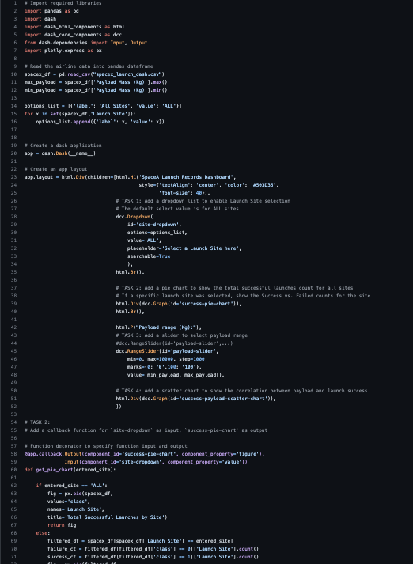
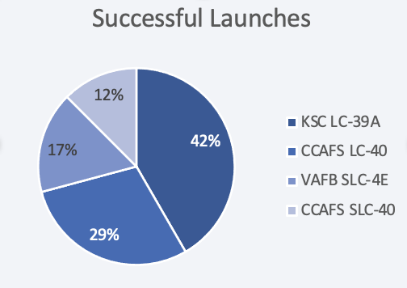
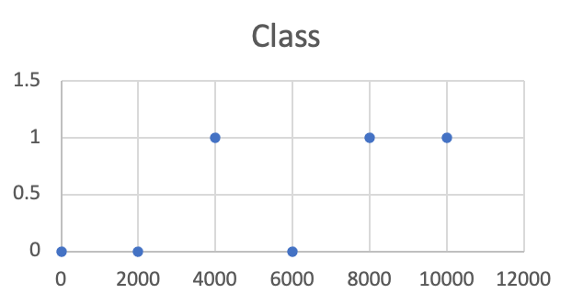
Build a Dashboard with Plotly Dash
I created a plot.ly dashboard with pie charts and scatter plots.
I also added a selection menu which allows me to switch between viewing all sites vs. narrowing in on the data for a single site.
The charts allow me to explore the relative success between sites and payload masses.
That said, the correlation is inconclusive.
View Jupyter notebook
Notes:
Summarize what plots/graphs and interactions you have added to a dashboard
Explain why you added those plots and interactions
Add the GitHub URL of your completed Plotly Dash lab, as an external reference and peer-review purpose

Slide 15
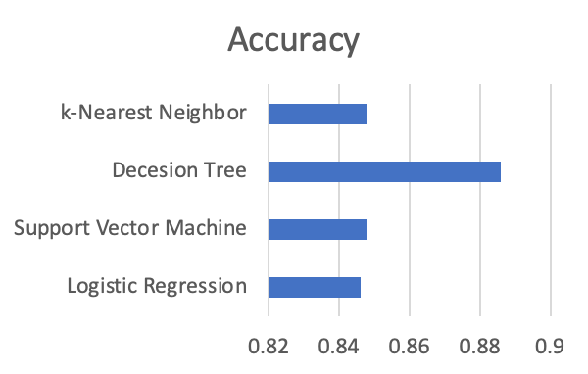
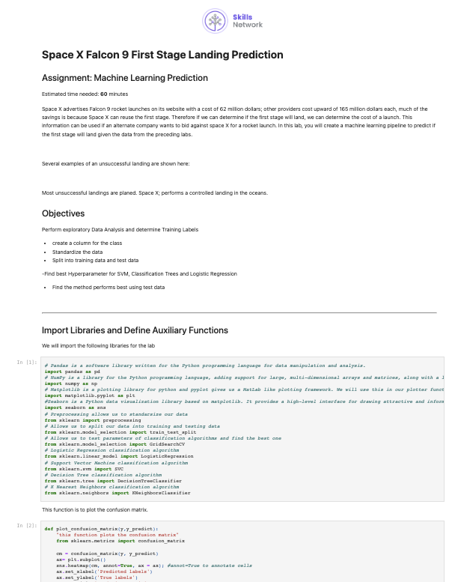
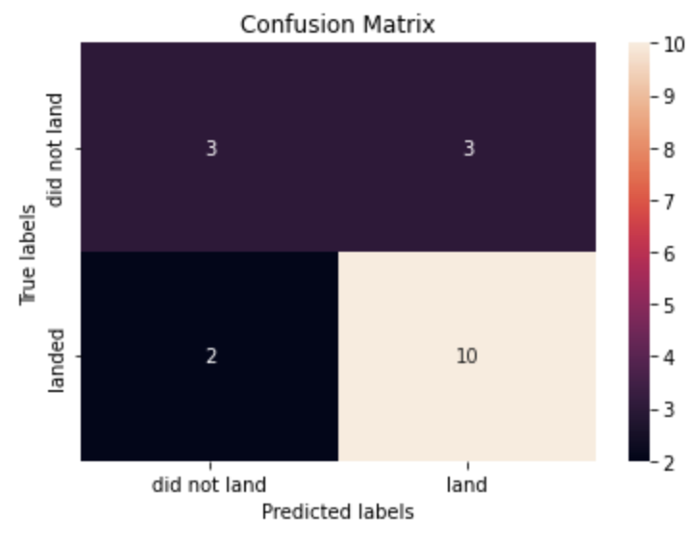
Predictive Analysis (Classification)
First I set the "class" column as the training label – the variable I wanted to predict.
Next, I split the data into training and test sets.
Then, I trained four different machine learning algorithms using the training data and compared the accuracy of each.
I visualized this accuracy using confusion matrices.
The best performing algorithm, with an accuracy of nearly 90%, was the Decision Tree Classifier.
View Jupyter notebook
Notes:
Summarize how you built, evaluated, improved, and found the best performing classification model
You need present your model development process using key phrases and flowchart
Add the GitHub URL of your completed predictive analysis lab, as an external reference and peer-review purpose

Slide 16
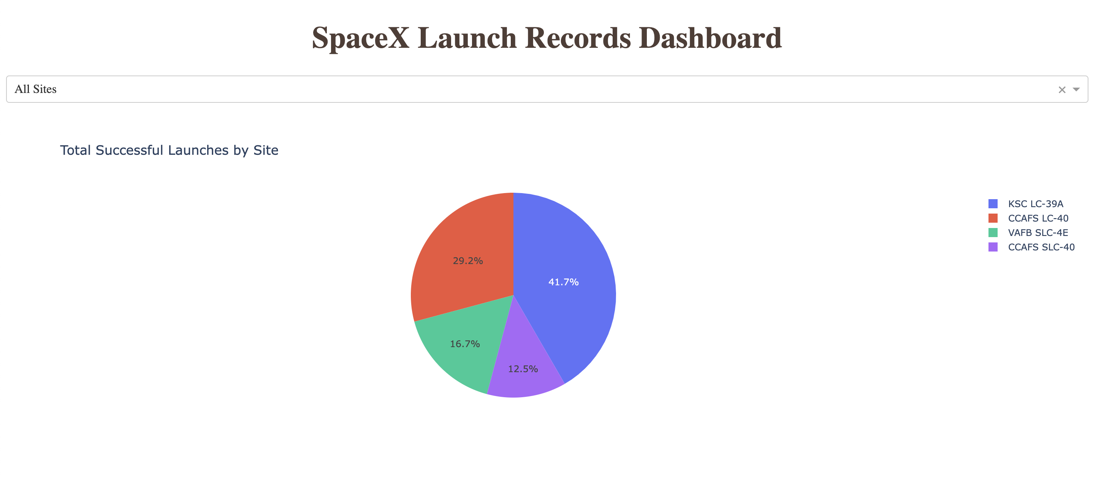
Results
EDA suggests that the strongest correlations are between flight number, payload weight, and landing success.
Predictive analysis can provide us with approximately 90% accuracy to predict landing failure or success.

Slide 17
Section 2
Insights drawn
from EDA

Slide 18
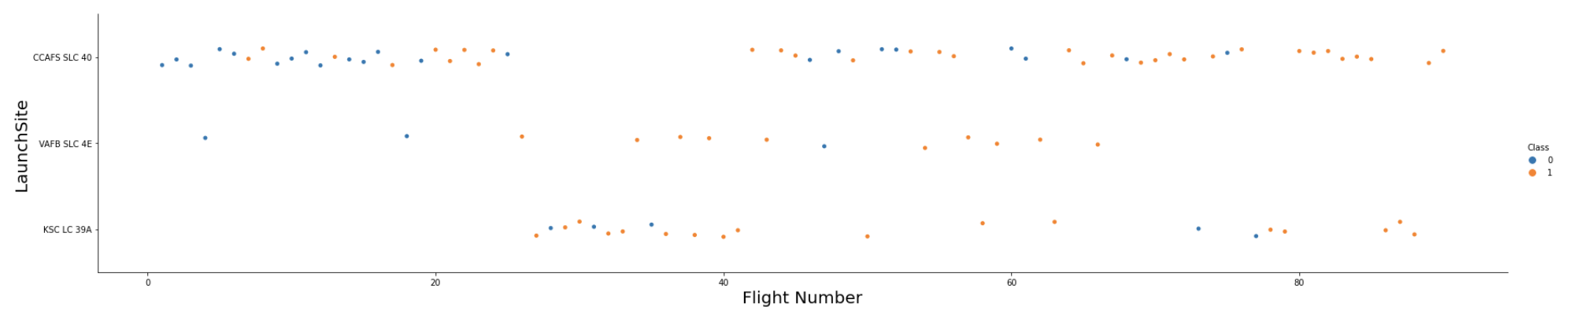
Flight Number vs. Launch Site
As would be expected, SpaceX’s success rate increased over time as they improved their technology and increased their collective organizational know-how.
Low success rate
Increasing success rate
100% Success
Notes:
Show a scatter plot of Flight Number vs. Launch Site
Show the screenshot of the scatter plot with explanations

Slide 19
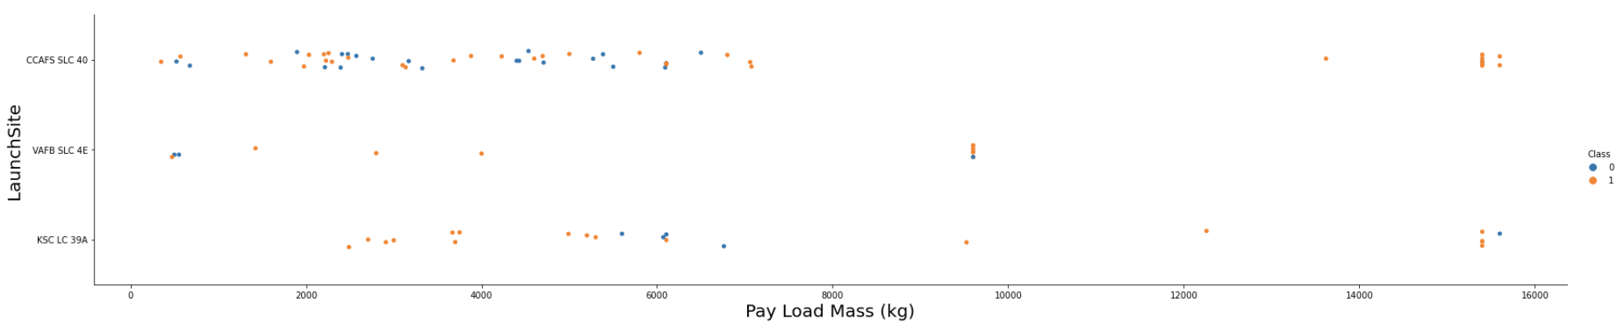
Payload vs. Launch Site
Across all sites, heavier payloads correlate positively with a higher success rate. Lighter payloads also perform well at the VAFB and KSC sites.
Lower success rate for smaller payload masses at CCASF SLC-40
High success rate for larger payload masses
Lighter payloads perform well at VAFB and KSC
Notes:
Show a scatter plot of Payload vs. Launch Site
Show the screenshot of the scatter plot with explanations

Slide 20
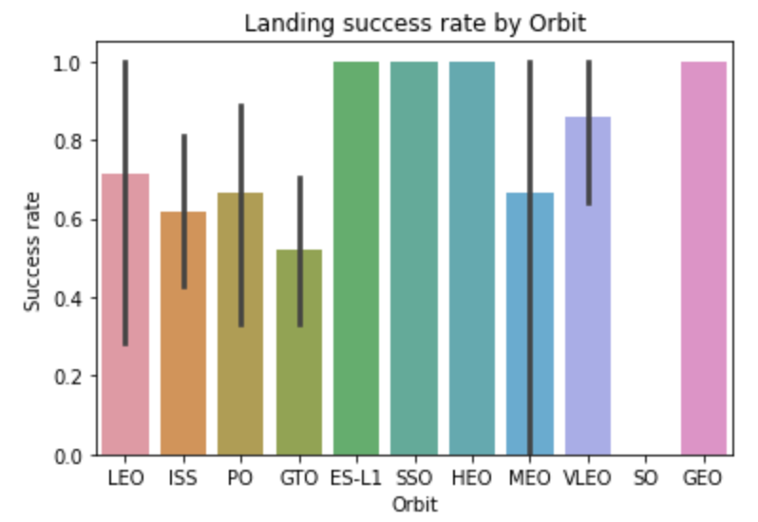
Success Rate vs. Orbit Type
Based on the included bar chart, we can see 100% landing success rate for orbits ES-L1, SSO, HEO, and GEO.
VLEO also has a relatively high success rate, which appears to be about 90%.
Notes:
Show a bar chart for the success rate of each orbit type
Show the screenshot of the scatter plot with explanations

Slide 21
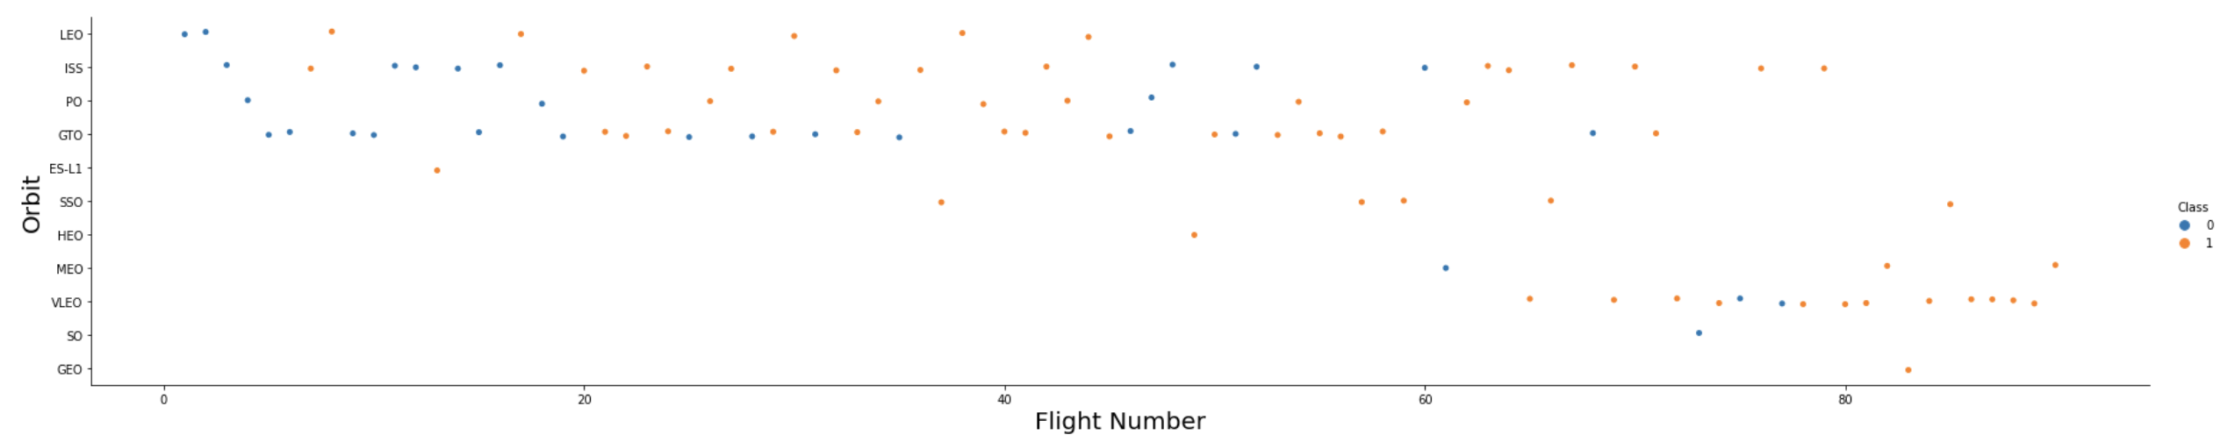
Flight Number vs. Orbit Type
As would be expected, SpaceX’s success rate increased over time as they improved their technology and increased their collective organizational know-how.
Notes:
Show a scatter point of Flight number vs. Orbit type
Show the screenshot of the scatter plot with explanations

Slide 22
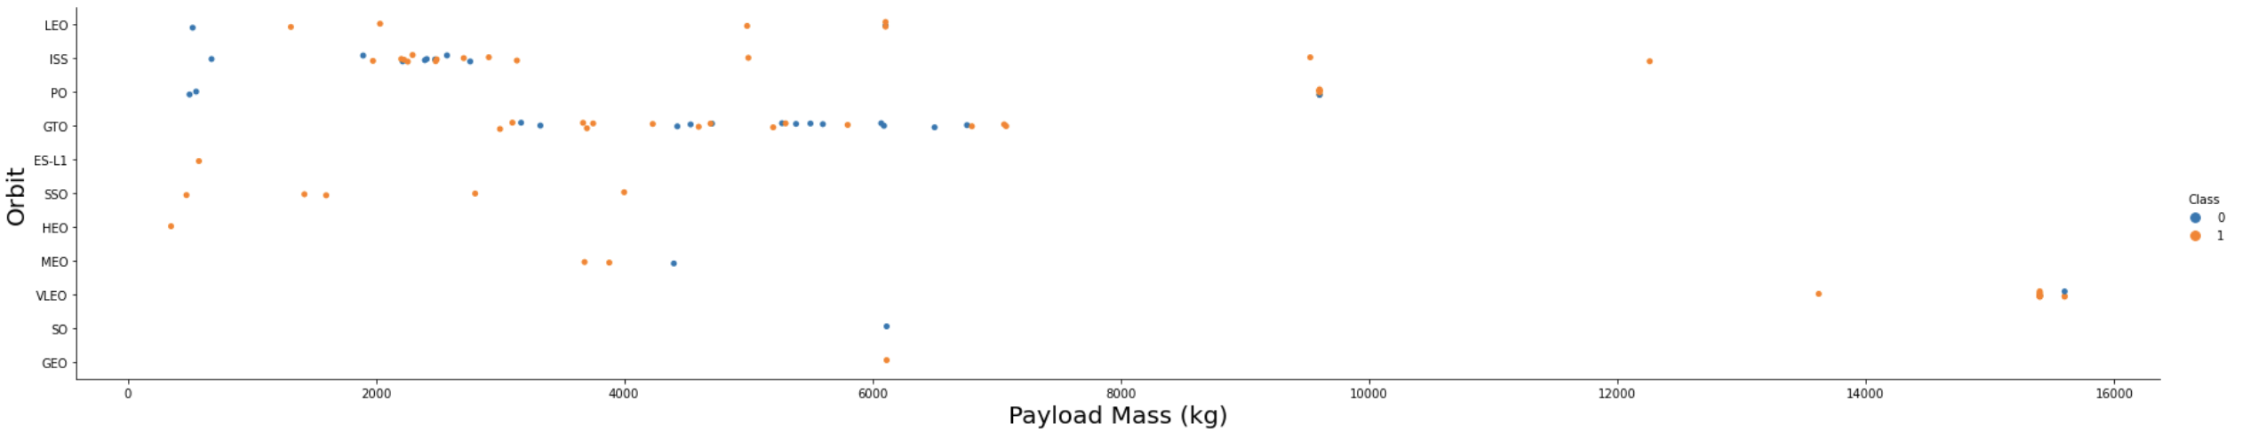
Payload vs. Orbit Type
Across all orbit types, heavier payloads correlate positively with a higher success rate.
Mixed success for lighter payload masses
High success rate for larger payload masses
Notes:
Show a scatter point of payload vs. orbit type
Show the screenshot of the scatter plot with explanations

Slide 23
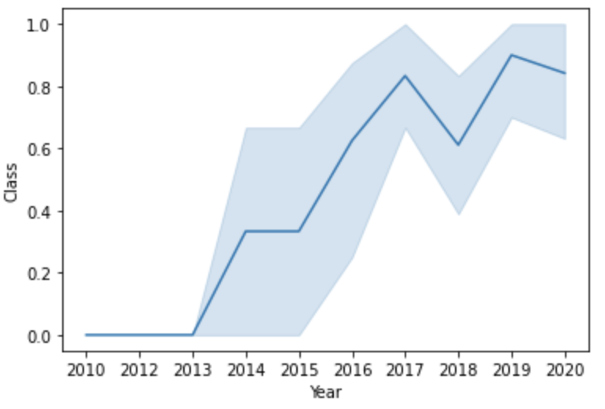
Launch Success Yearly Trend
As would be expected, SpaceX’s success rate increased over time as they improved their technology and increased their collective organizational know-how.
Notes:
Show a line chart of yearly average success rate
Show the screenshot of the scatter plot with explanations

Slide 24
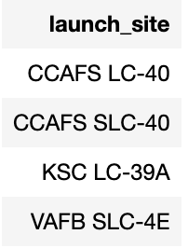
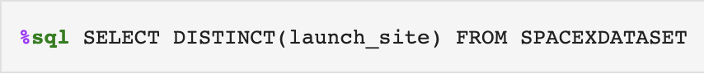
All Launch Site Names
Using the DISTINCT() function in SQL, I was able to get a list of each unique launch site in the provided data set.
Notes:
Find the names of the unique launch sites
Present your query result with a short explanation here

Slide 25
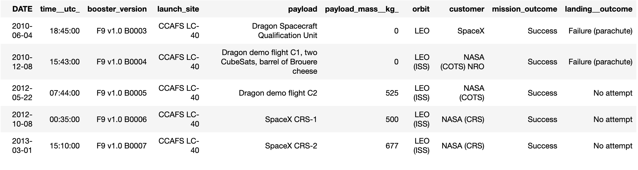
Launch Site Names Begin with 'CCA'
Using the LIKE operator, I queried the data set for all launch sites whose name begins with “CCA.”
Notes:
Find 5 records where launch sites begin with `CCA`
Present your query result with a short explanation here

Slide 26
Total Payload Mass
45596 kg
10000 kg
10000 kg
10000 kg
10000 kg
Using the SUM() function in SQL, I was able to add up the total payload mass of the missions for the customer NASA.
Notes:
Calculate the total payload carried by boosters from NASA
Present your query result with a short explanation here

Slide 27
Average Payload Mass by F9 v1.1
Using the AVG() function in SQL, I was able to get the mean payload mass per mission flown with the F9 v1.1 booster.
2534 kg mean payload mass
Notes:
Calculate the average payload mass carried by booster version F9 v1.1
Present your query result with a short explanation here

Slide 28


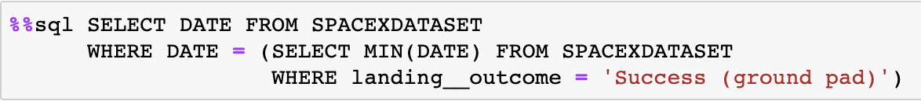
First Successful Ground Landing Date
Using a subquery with the MIN() and DATE functions, I was able to determine the date of the mission with the first successful landing outcome.
Dec 22, 2015
Notes:
Find the dates of the first successful landing outcome on ground pad
Present your query result with a short explanation here

Slide 29
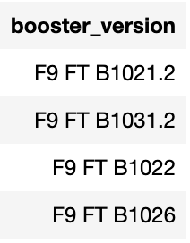
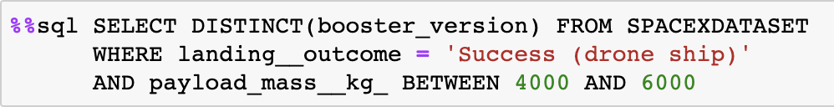
Successful Drone Ship Landing with Payload between 4000 and 6000
Using the BETWEEN operator provided by SQL, I was able to determine which distinct booster versions with payloads between 4000 kgs and 6000 kgs had successfully landed on a drone ship.
Notes:
List the names of boosters which have successfully landed on drone ship and had payload mass greater than 4000 but less than 6000
Present your query result with a short explanation here

Slide 30
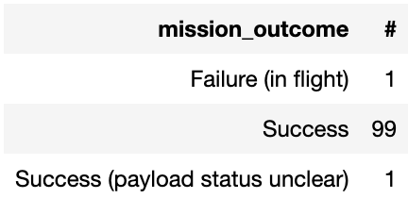
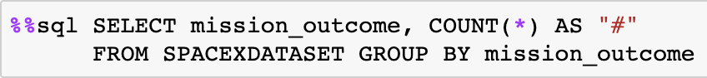
Total Number of Successful and Failure Mission Outcomes
Using the GROUP BY and COUNT() functions provided by SQL, I was able to determine the total number of successful and failure outcomes, including one mixed/unclear outcome.
Notes:
Calculate the total number of successful and failure mission outcomes
Present your query result with a short explanation here

Slide 31
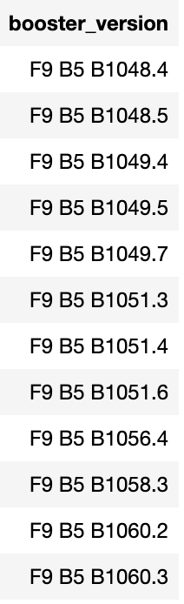
Boosters Carried Maximum Payload
Using the DISTINCT() method and MAX() method in a subquery, I was able to determine which booster versions had carried the maximum payload.
Notes:
List the names of the booster which have carried the maximum payload mass
Present your query result with a short explanation here

Slide 32
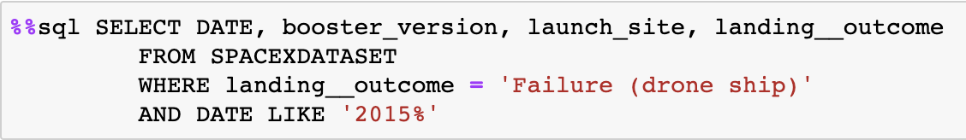
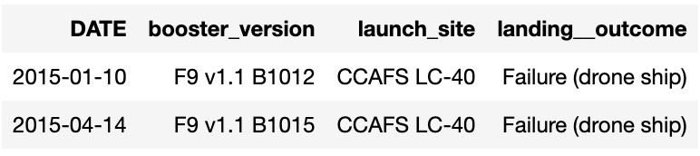
2015 Launch Records
Using the DATE function and AND LIKE operator, I was able to determine the failed drone ship landings in 2015.
Notes:
List the failed landing_outcomes in drone ship, their booster versions, and launch site names for in year 2015
Present your query result with a short explanation here

Slide 33
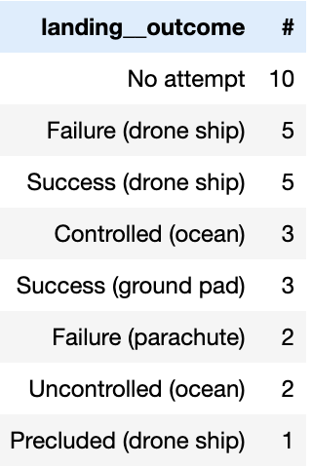
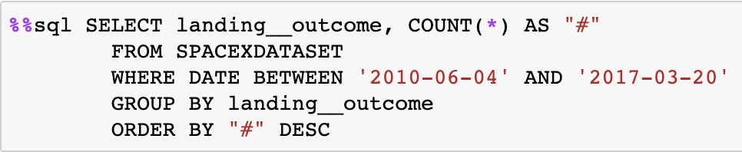
Rank Landing Outcomes Between 2010-06-04 and 2017-03-20
Using the COUNT, GROUP BY, and ORDER BY functions provided by SQL, I was able to rank the landing outcomes by count for the dates between 2010-06-04 and 2017-03-20.
Notes:
Rank the count of landing outcomes (such as Failure (drone ship) or Success (ground pad)) between the date 2010-06-04 and 2017-03-20, in descending order
Present your query result with a short explanation here

Slide 34

Section 3

Slide 35
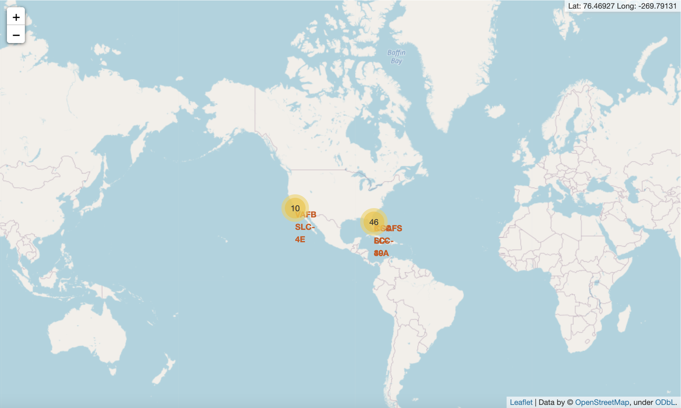
Global SpaceX Launch Locations
Both launch locations are:
On the coast
Relatively close to the equator
In the United States
Equator
Notes:
Replace <Folium map screenshot 1> title with an appropriate title
Explore the generated folium map and make a proper screenshot to include all launch sites’ location markers on a global map
Explain the important elements and findings on the screenshot

Slide 36
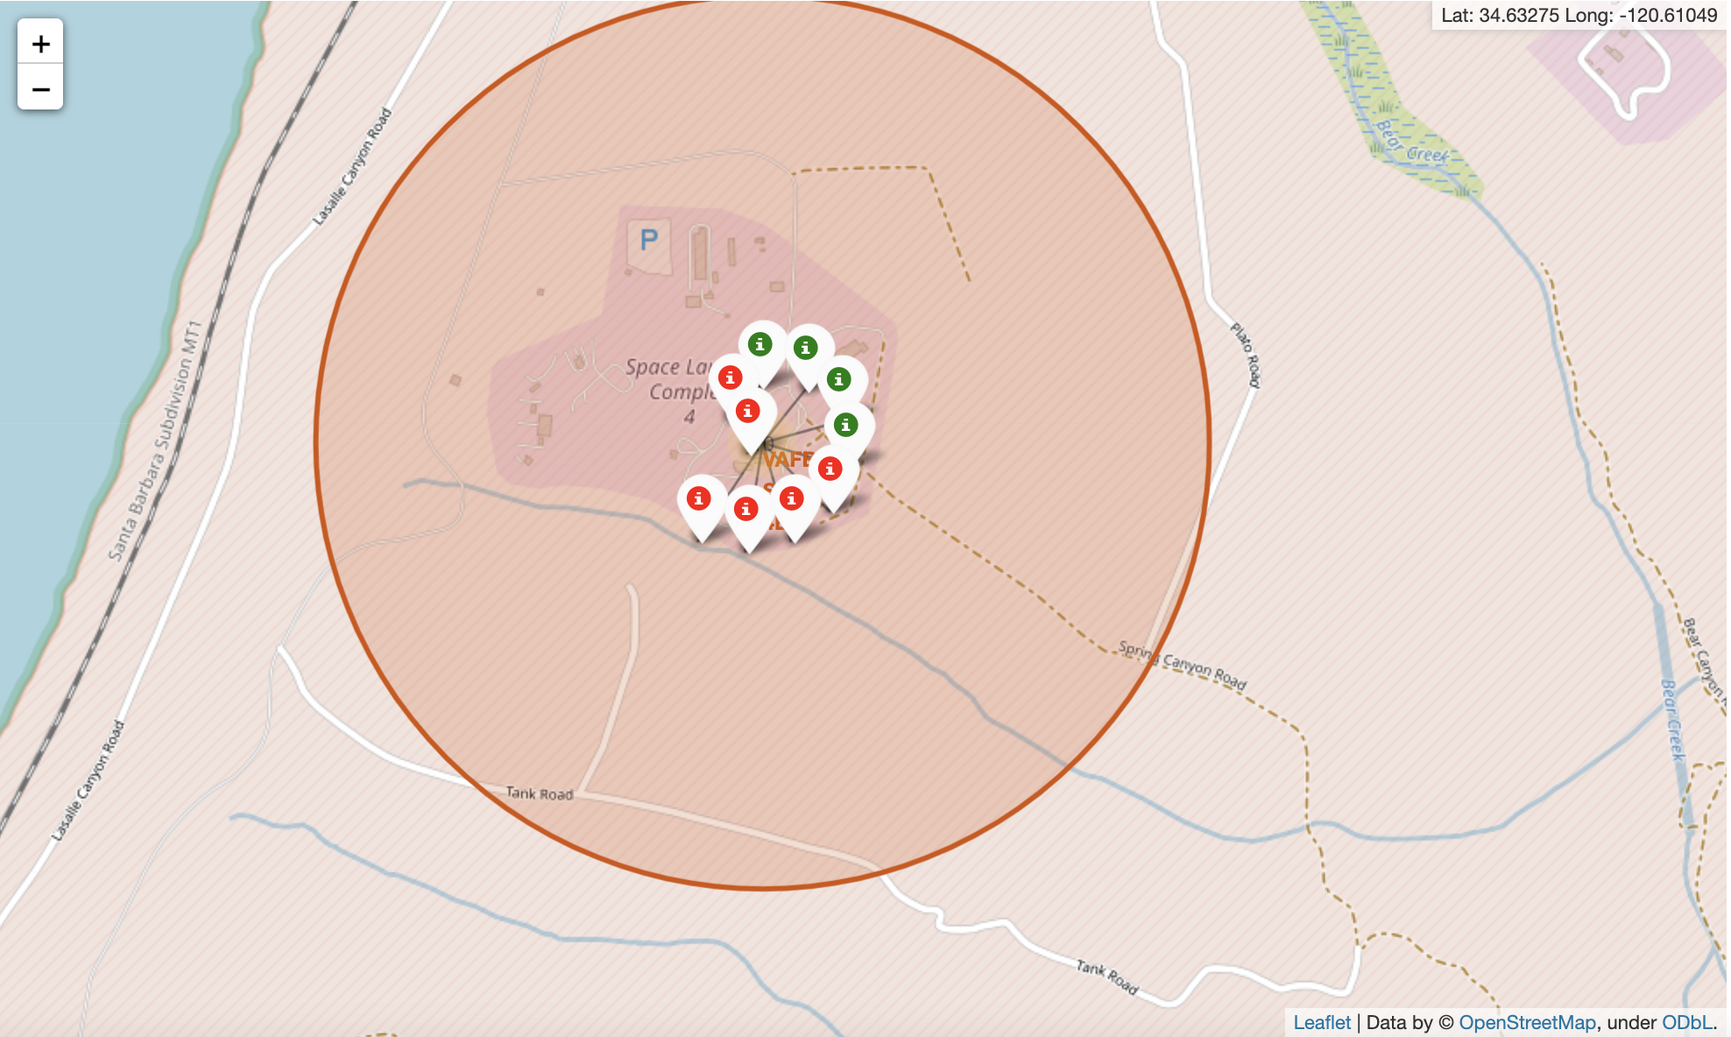
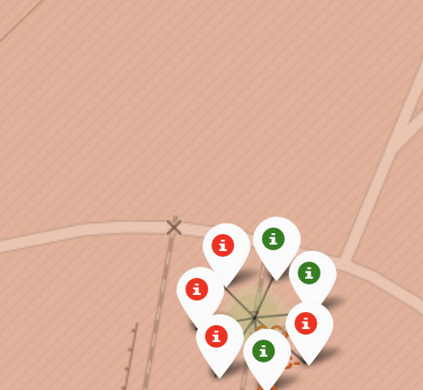
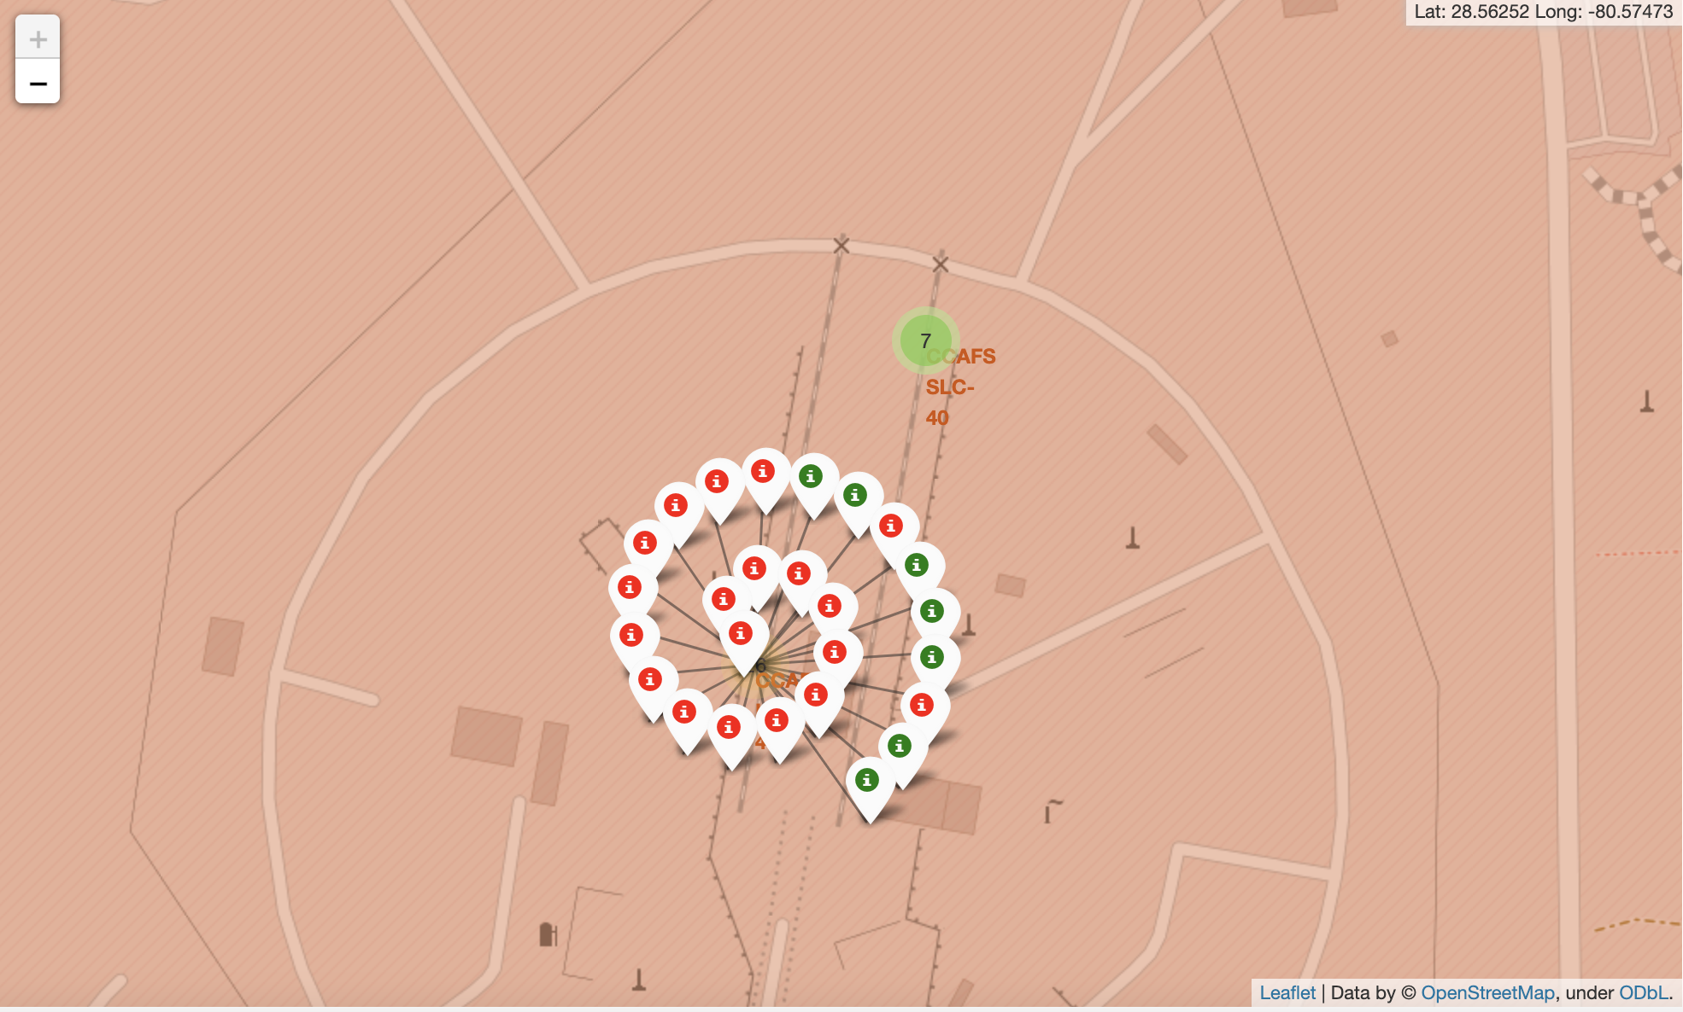
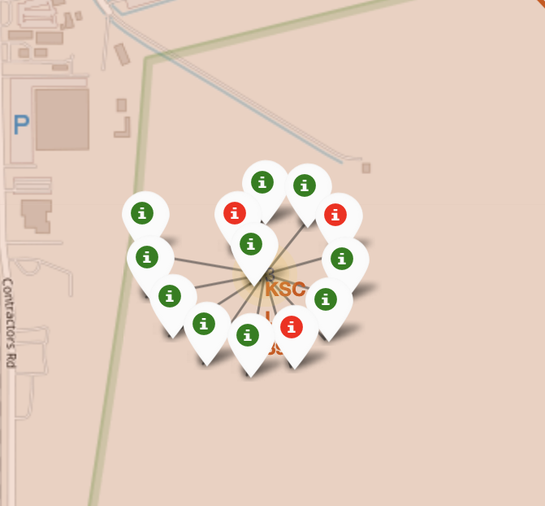
Launch outcomes
We see mixed launch outcomes across all 4 main launch sites
Replace <Folium map screenshot 2> title with an appropriate title
Explore the folium map and make a proper screenshot to show the color-labeled launch outcomes on the map
Explain the important elements and findings on the screenshot
Notes:
Replace <Folium map screenshot 2> title with an appropriate title
Explore the folium map and make a proper screenshot to show the color-labeled launch outcomes on the map
Explain the important elements and findings on the screenshot

Slide 37
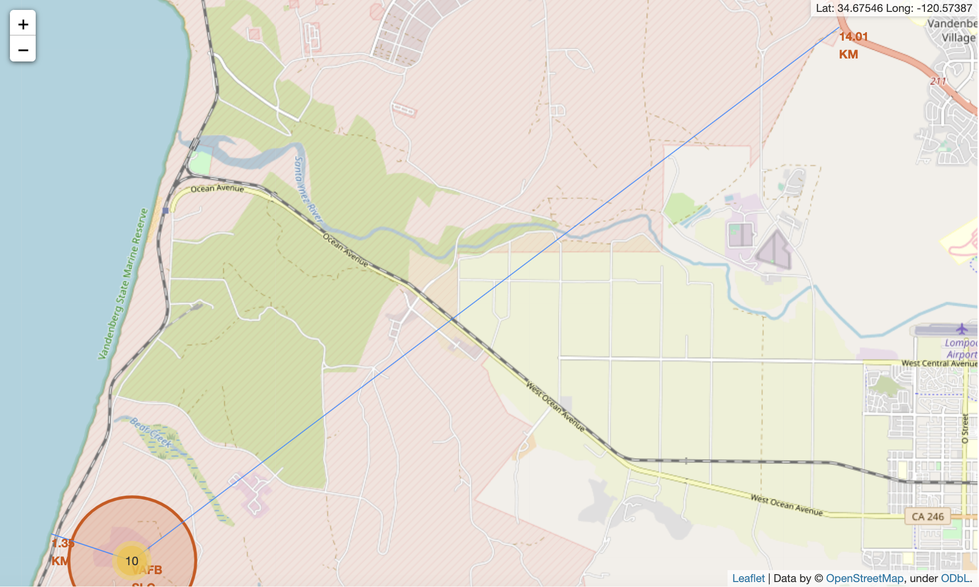
Launch site proximity
We see that the launch site is close to the coast line, and far away from an city, highway, or railway.
Notes:
Replace <Folium map screenshot 3> title with an appropriate title
Explore the generated folium map and show the screenshot of a selected launch site to its proximities such as railway, highway, coastline, with distance calculated and displayed
Explain the important elements and findings on the screenshot

Slide 38

Section 4

Slide 39
Total successful launches by site
All four launch sites had successful launches. KSC LC-40 had the most, while CCASF SLC-40 had the fewest.
Notes:
Replace <Dashboard screenshot 1> title with an appropriate title
Show the screenshot of launch success count for all sites, in a piechart
Explain the important elements and findings on the screenshot

Slide 40
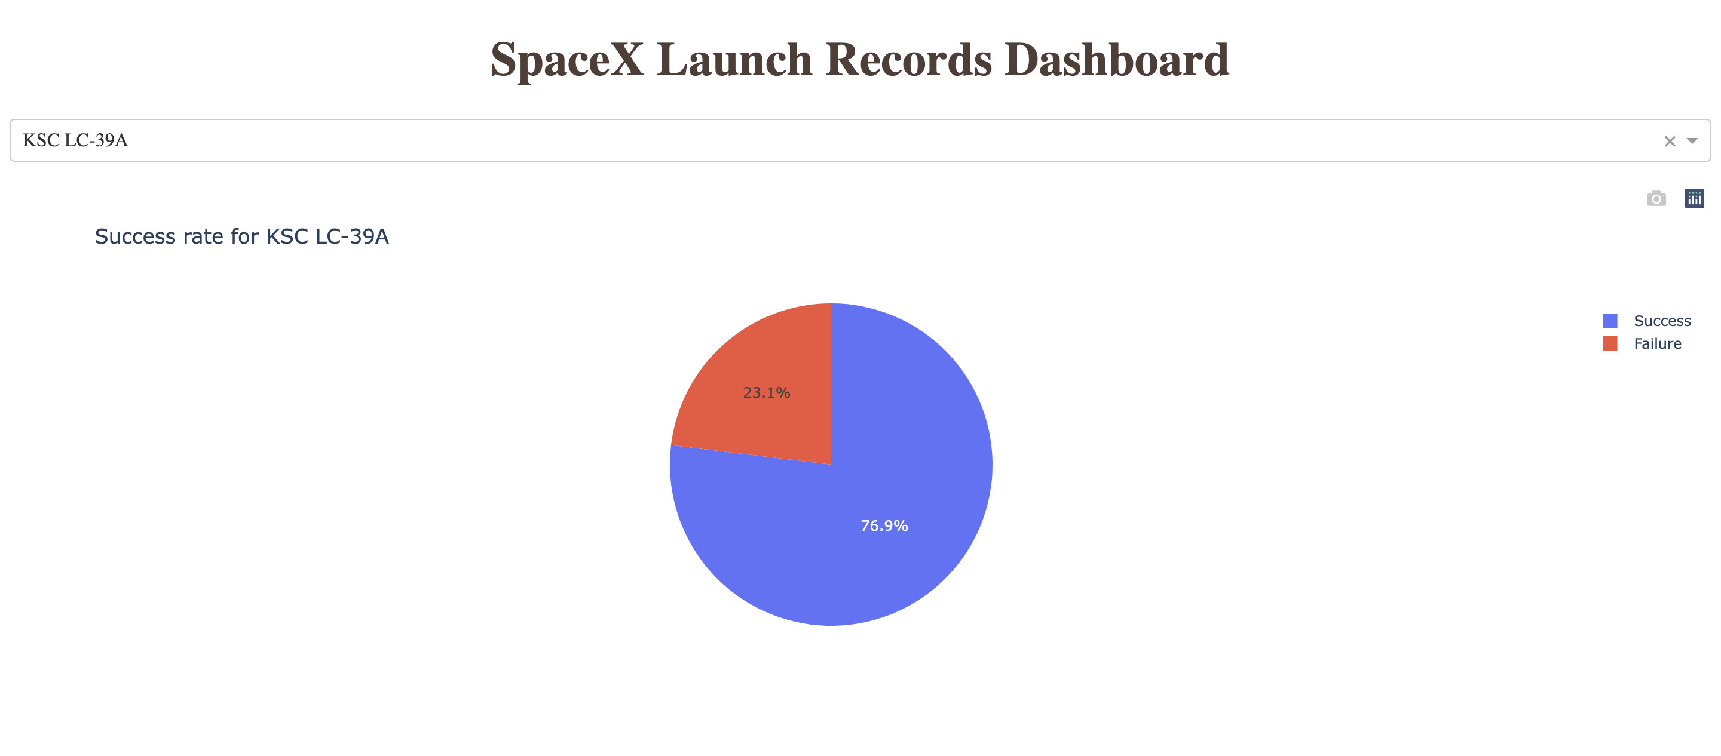
KSC LC-39A
The site with the highest success rate – 76.9% – is KSC LC-39A
Notes:
Replace <Dashboard screenshot 2> title with an appropriate title
Show the screenshot of the piechart for the launch site with highest launch success ratio
Explain the important elements and findings on the screenshot

Slide 41
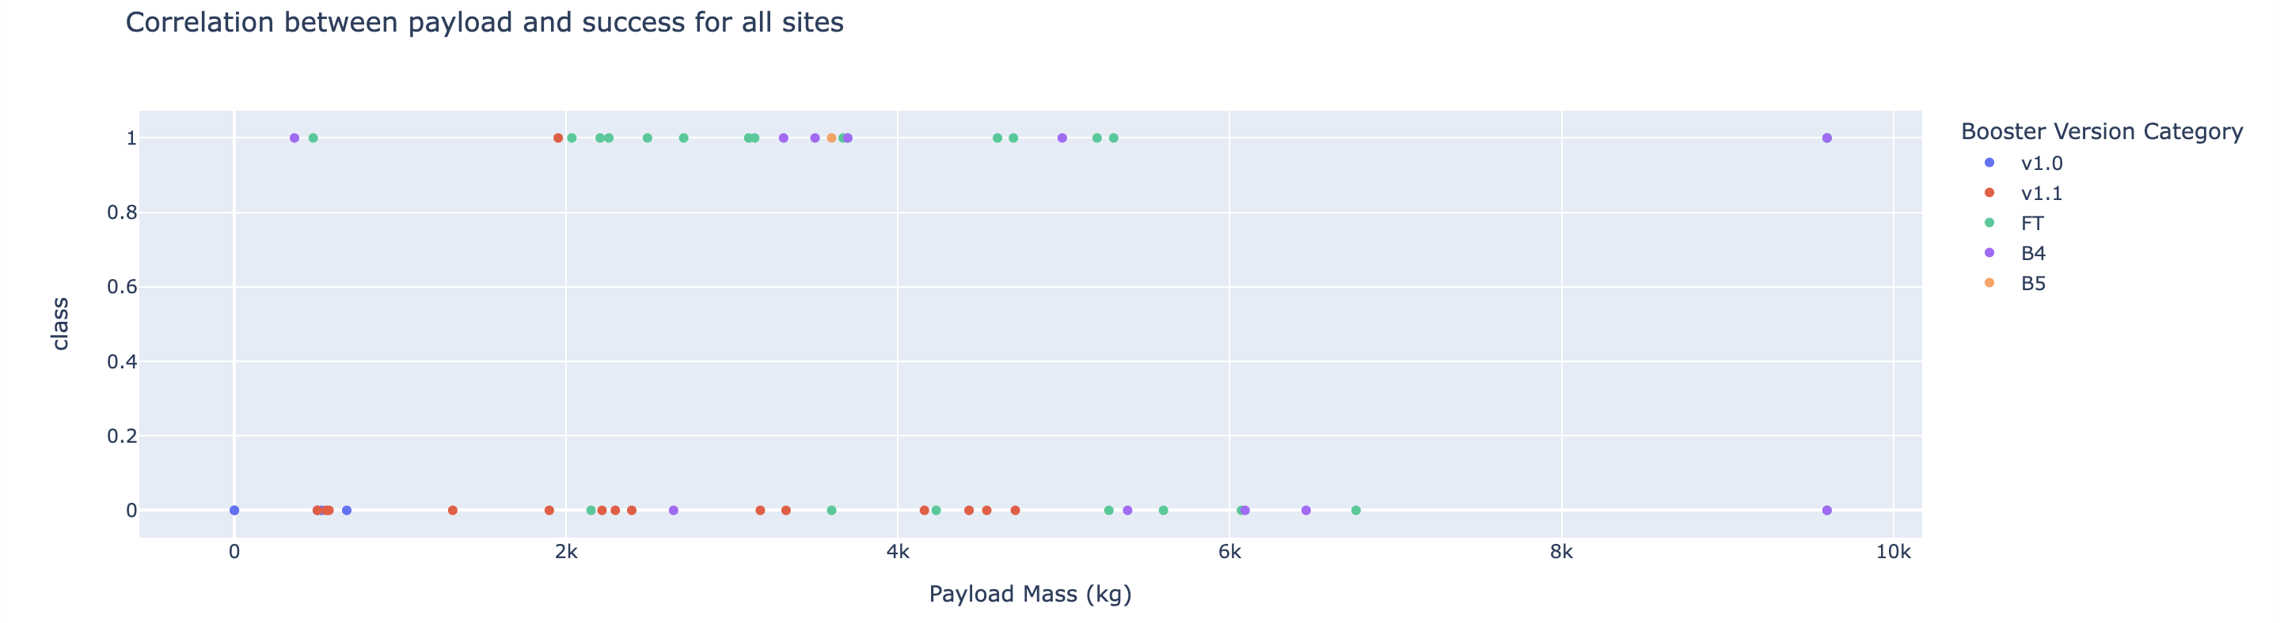
Boosters and Payloads
We see that the FT booster series has a high success rate, the v1.1 has a relatively low success rate.
Notes:
Replace <Dashboard screenshot 3> title with an appropriate title
Show screenshots of Payload vs. Launch Outcome scatter plot for all sites, with different payload selected in the range slider
Explain the important elements and findings on the screenshot, such as which payload range or booster version have the largest success rate, etc.

Slide 42

Section 5

Slide 43
Classification Accuracy
The best performing algorithm, with an accuracy of nearly 90%, was the Decision Tree Classifier.
Notes:
Visualize the built model accuracy for all built classification models, in a bar chart
Find which model has the highest classification accuracy

Slide 44
Confusion Matrix
This confusion matrix shows that, in reality, there were 6 missions which did not land. Our model would have predicted that 5 did not land.
In reality, there were 12 successful landings. Our model would have predicted 13 successful landings.
All in all, this is a relatively accurate model.
Notes:
Show the confusion matrix of the best performing model with an explanation

Slide 45
Conclusions
SpaceX has gotten better over time. This alone accounts for a high degree of success as there is a strong positive correlation between flight number and landing success.
Heavier payloads seem to translate to a higher success rate
Launch site does not seem to correlate strongly with failure or success…. It’s mixed across sites.
Using the model I’ve created, we should be able to predict success with an accuracy of approximately 90%.

